Slide 1
Refactoring the Architect’s Role

Slide 2







About Yogi
Technical leader with 10+ years experience developing a diverse array of systems. He has a career spanning clients in manufacturing, retail, healthcare, marketing and finance sector. He has spoken at conferences and user group meetings. He also likes to blog about technical topics. His enthusiasm about technology makes him an asset to a team.
Blog
https://aradhye.com/
yaradhye
yogiaradhye
YogirajA
Yogiraj Aradhye
Principal Consultant

Slide 3
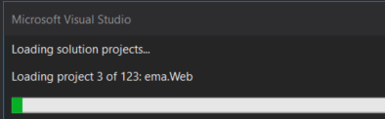
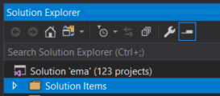

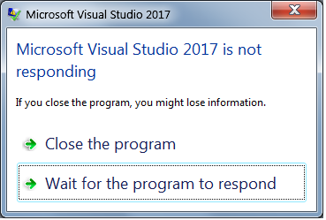
Monolith Architecture
User Interface
Business Logic
Data Interface
DB

Slide 4
Software whose design, information model, and interface combine multiple competing and interfering domains into one single application and data model.
Jimmy Bogard

Slide 5


Slide 6
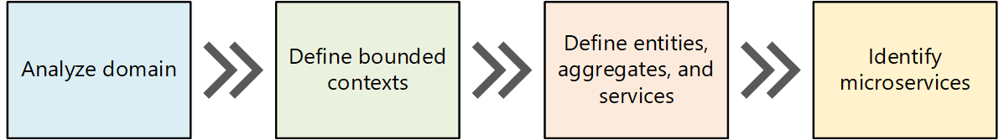
Breaking up the Monolith Using DDD
Microsoft Guidelines

Slide 7
The first service went live, and life was great

Slide 8

The Spawn
Source: D3js

Slide 10


Slide 11
And the architecture group was formed

Slide 12
Idea of the Architecture Team
Reign in the madness
Make sure the teams are doing the right thing
Help teams achieve their goals
Bring uniformity

Slide 13

SYMPTOMS

Slide 14
You say architecture, the agile folks hear waterfall

Slide 15
Shotgun Wedding
Forced
Contentious meetings
Agile scrum masters pushed back hard.
“We are doing it this way because architecture is telling us that.”

Slide 16
Negative Productivity
Always busy though
Always playing from behind
Many different initiatives
Scattered brain
Platforms, tools and patterns

Slide 17
Unclear Mission
What is our collective goal?
Confusion about the role
Advisor or consultancy wasn’t natural to everyone
Working on too many stories or not writing code at all
Not much accountability
Artifacts? Patterns, frameworks, or docs?

Slide 18
Result
Very little to show for at the end of the day
Burnouts
Business impact
Inefficiency
Ineffective

Slide 20

Analysis

Slide 21
Why Architecture?
Every system has an architecture
If not done at the right time, architecture will eventually choose you
Can save money and headache by avoiding expensive mistakes
Helps in onboarding new engineers

Slide 22




Slide 23
Analysis
Smells: Point at a deeper problem than what you see at the surface level
Not technically incorrect
Subtle inefficiencies cause trouble
Refactoring: Restructuring without changing the output
Not a redo
No disbanding
Rethink what we are doing

Slide 24

SMELLS AND REFACTORINGS

Slide 25
Confusion About What Is Architecture
What is architecture?
Pie in the sky?
Tons of wiki fillers?
Pretty pictures all over the place?
Ivory tower trolling?
Waterfall

Slide 26
Shared Understanding of the system
Martin Fowler

Slide 27
Things you wish to get right early in your system
Ralph Johnson
Gang of four patterns

Slide 28
Design decisions about any system that keep implementers and maintainers from exercising needless creativity
DSouza, Wills
Objects, Components, and Frameworks in UML.

Slide 29
Architecture Definition
Change
What makes your system easier to change
Keeping an eye on $
Your architecture will affect how much you spend
Important parts
What are some unique or important items in your system
Some aspect that are unique to the system
Something that ties these pieces together

Slide 30
Agile and Architecture
Agile
Efficiency
Architecture
Effectiveness

Slide 31
Architecture Definition Refactoring
Change
Concentrate on
Ease of change
Important aspects of the system
DevOps
Work with agile PMs closely
Repeat the message until anyone in the org can rattle it out

Slide 32
What Makes Change Easier?
Events
Systems dont have change that much
Vertical slices instead of layers
System modeled to the usage
Robust DevOps
Resilient pipelines means you can deploy often without fear

Slide 33
2. Documentation Issues
Essential for async communication
Wall of text
No illustrations
Too much info in one diagram

Slide 34
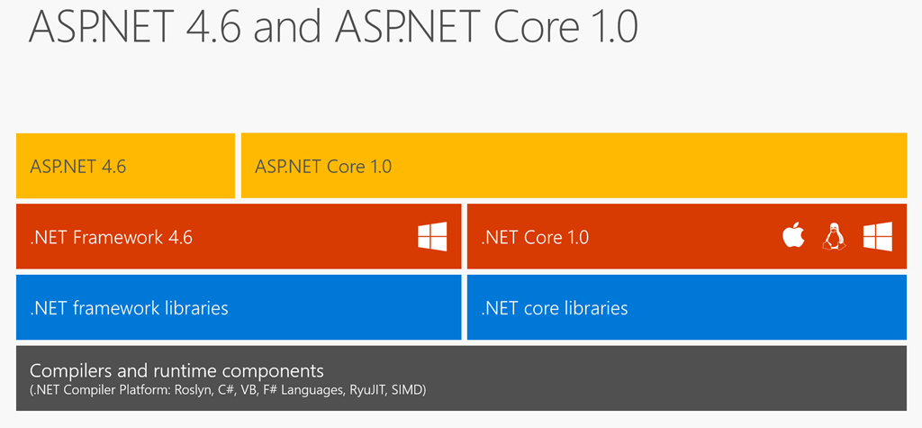
Documentation Refactor With Diagrams
Hanselman.com

Slide 35

https://themodernproper.com/

Slide 36
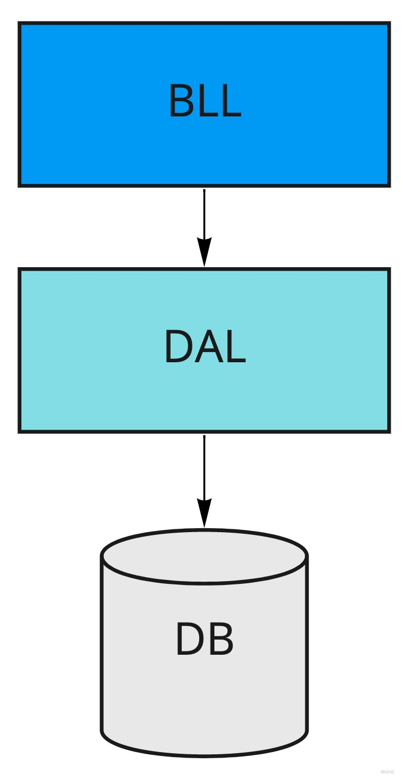
Documentation Refactor With Diagrams

Slide 37
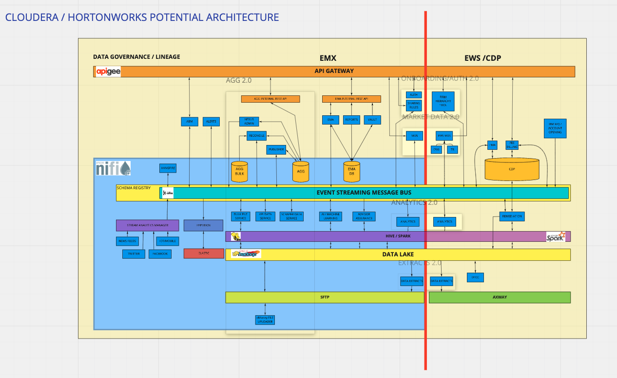
Documentation Refactor With Diagrams

Slide 38
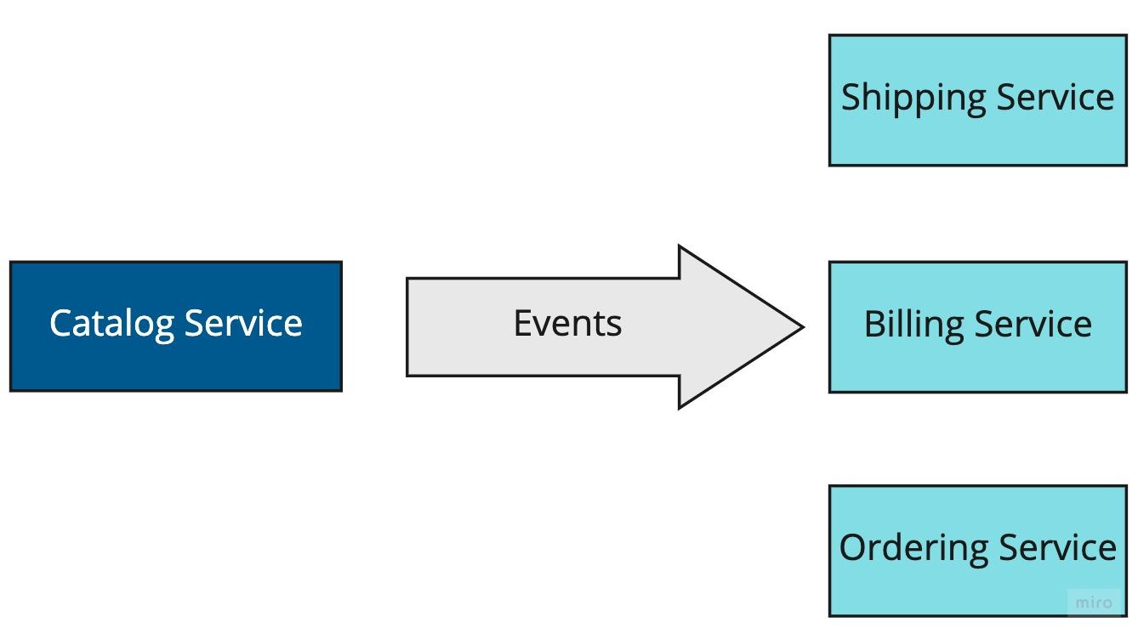
Documentation Refactor With Diagrams

Slide 39
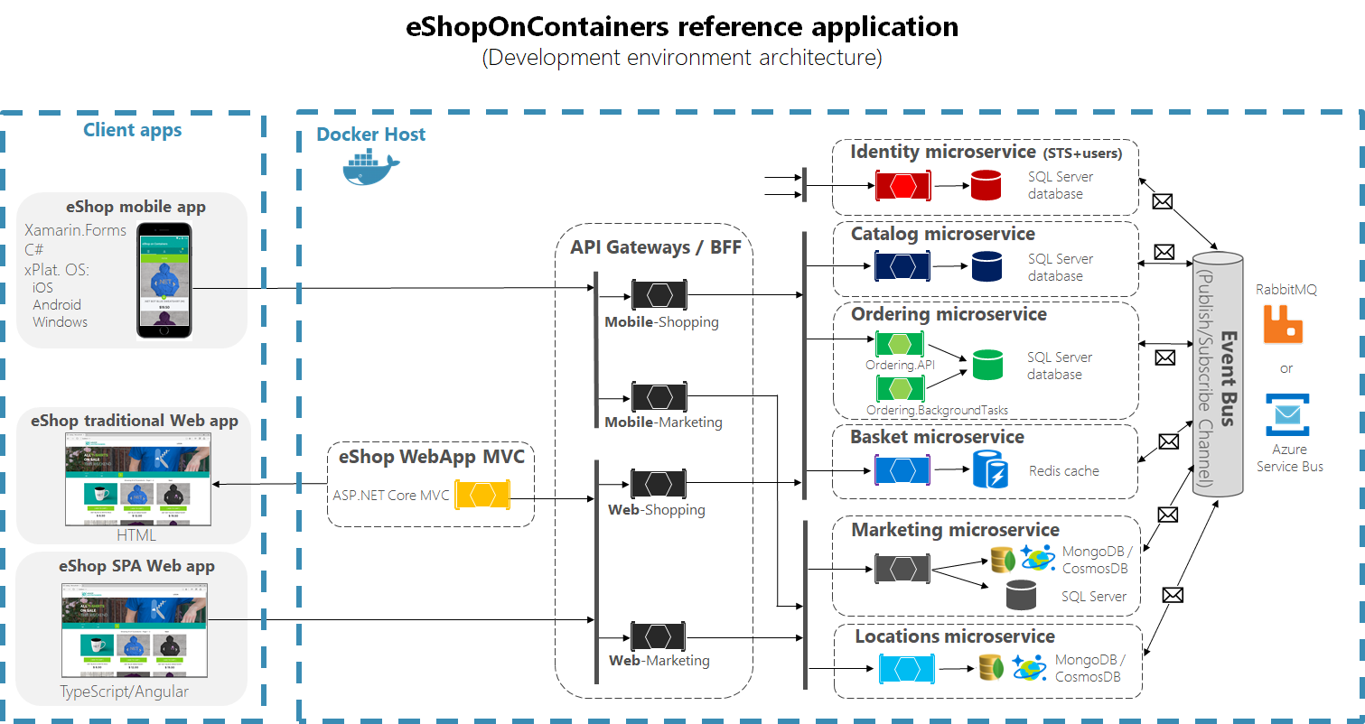

Slide 40
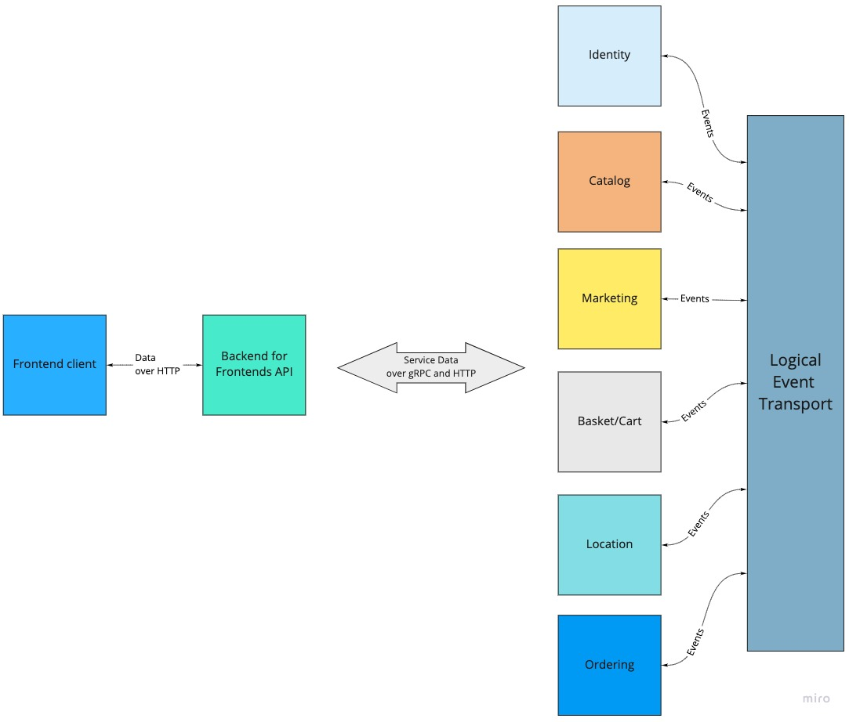

Slide 41
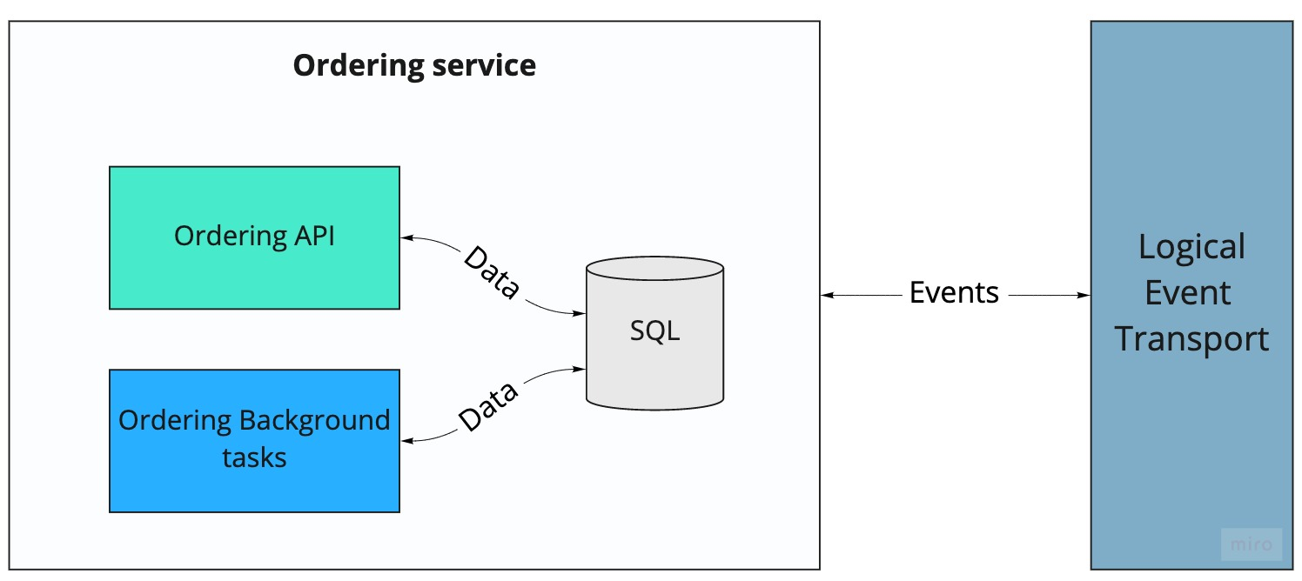

Slide 43
Documentation Refactor With Diagrams
Less is more when importance is covered
You can’t force anyone to read the doc
Emphasis on important aspect instead of completeness
Use known convention if possible
Know the purpose of the diagram
Break them down if needed
Security views, perf views, sequence diagrams, flow charts, etc

Slide 44


Slide 45
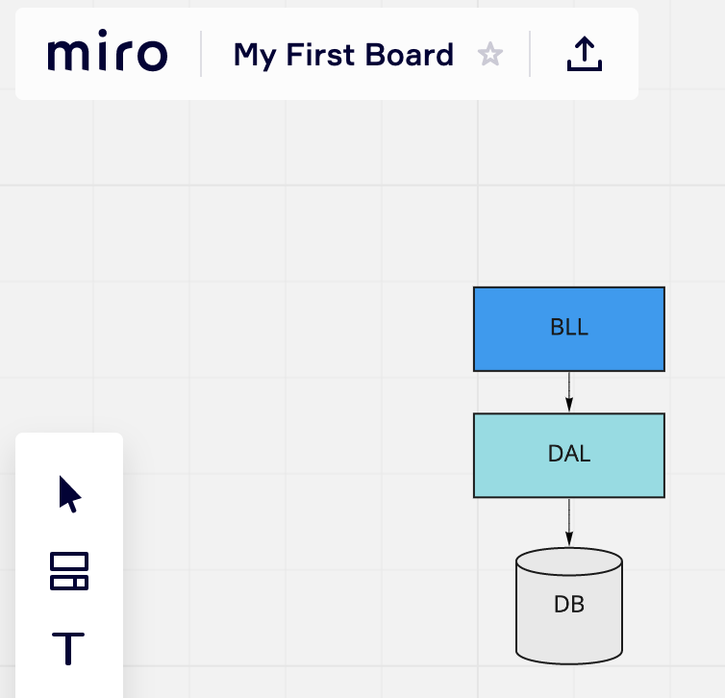



Slide 46
3. Premature Solutioning
Jumping too early on to the coolest buzzword
Microservices
Containers and Kubernetes
Cloud
Serverless
Pie in the sky

Slide 47
What Causes Premature Solutioning?
Pie in the sky
Continuously working in synchronous fashion
Meetings, Workshops, etc
Lack of observability
Not working on an actual business problem
Infinite noodling on hypotheticals
Lack of homework and research

Slide 48
Premature Solutioning Refactoring
Build as much clarity as possible on the “What”
The “How” will follow
Show how to measure
Test driven development approach
If you can write tests for it, you can build it
Add enough tactical details close to execution time
Developers will appreciate that

Slide 49

4. Architecture Vision
Addressing Symptoms

Slide 50
Architecture Vision
Symptoms
My system is slow
Underlying problem
I make unnecessary expensive synchronous calls to other services
That data doesn’t change often

Slide 51
Architecture Vision Refactoring
Avoid patching the symptoms
Lets make our synchronous call faster and reliable
Address the root problem
Why do we need this call? Do we have incorrect service boundaries?
Can the source push the data instead?

Slide 52


Slide 53


Slide 54
5. Architecture Review
Architecture review
Dreaded
Design by committee meetings
Neither side got much out of it

Slide 55
Architecture Review Refactoring
Architecture review
Two way process
Strong opinions weakly held
Scientific method style
Honest empathetic feedback
Everyone should know what to expect
Need should taper off with time

Slide 56
When to Review
Architecture review
When you are making an important decision?
Changing an existing event structure
Creating a new service
Building a framework?
Going away from the existing tech stack
User experience

Slide 57
Architecture Review Hit List
Architecture hit list
Transaction boundaries and Distributed transactions
Failure management
Understand coupling
Microservices
Async vs sync integration patterns
Observability

Slide 58

6. Working Culture

Slide 59
Working Culture
World just doesn’t work synchronously
Meetings
Workshops
Constant Ad Hoc conversations

Slide 60
Working Culture
Scattered Brain
Taking on too many things at once
Less productivity

Slide 61
Working Culture Refactoring Inspiration
The open source software development
AutoMapper stats
2420 issues resolved
100 + contributor across the world
One open issue
Millions of download

Slide 62
Working Culture Refactoring Inspiration
The open source software development
No meetings
Gitter/Slack Channels but rarely a 1x1 pings
Core maintainers
Decent documentation developed collaboratively

Slide 63
Working Culture Refactoring
Conway’s law
Structure teams to look like your target architecture, and it will be easier to achieve it. - Building evolutionary architecture book
Easier said than done but possible

Slide 64
Working Culture Refactoring
Communication
Publicize architecture vision
Repeat on different forums
Show actions and results

Slide 65
Working Culture Refactoring
Push for asynchrony
Email instead of meetings
No meeting without clearly defined agenda
No meeting without homework

Slide 66
Working Culture Refactoring
Accountability
Regular rhythms on work deliverables
Kanban or any simple technique
Screen casts, presentations and newsletters

Slide 67
Working Culture Refactoring
Development team for architectural work
Rotational volunteers
Keep them focused on tasks
Maintenance
Timeboxed

Slide 68
Working Culture Refactoring
Empathy : The ability to understand and share the feelings of another
Understand the deadlines
Understand the motives
Know when to walk away or take a break
Don’t be another blocker
Do as I do instead of constant criticising

Slide 69

7. Role Of The Architect, The Confusion

Slide 70
7. Role Of The Architect, The Confusion
What are you supposed to do?
High level pictures?
Code?
Maintenance or big project?

Slide 71
Role Of The Architect Refactoring
Must code! Extract Patterns
Extract instead of set
Must be deployed in production at least 2 times
3rd need is coming up
Avoid building for hypotheticals
Measure and test at every step

Slide 72
Design decisions about any system that keep implementers and maintainers from exercising needless creativity
DSouza, Wills
Objects, Components, and Frameworks in UML.

Slide 73
Role Of The Architect Refactoring
Must Code! Pairing
When you see the need
Typically happens with inexperienced teams
Set the correct expectations
Choose the correct problems
Lay down the groundwork so that the engineers don’t have to be overly creative

Slide 74
Role Of The Architect Refactoring
High Level and big picture work
Where does the task fit in the big picture?
How does it improve our system?
How do we deliver the business value?

Slide 75
Role Of The Architect Refactoring
Strong opinions loosely held - Paul Staffo, Stanford Professor
Start with your experienced intuitions
Willing to change it when the data comes up
Sets an example

Slide 76
Be the change you believe in
Disputed

Slide 77
Role Of The Architect Refactoring
Do as I do
Example of your program, diagrams and documentation
Show the value in starting quickly
For example: Events.. Start with name, ID and timestamp.. Build other properties over time

Slide 78
Role Of The Architecture Refactoring
Avoid tool, vendor and tool pushing
Nothing turns off everyone more than seeing all kinds of logos in an architecture
Vendor lock ins
Classic solution first

Slide 79
Role Of The Architect Refactoring
Not a manager
Can’t be part of the people management
Different role than organizational work
Don’t distract them with this work

Slide 80
Role Of The Architect Refactoring
Play to the strengths
Don’t force to be the jack all
Honor expertise and interests
Avoid painting someone in the corner
Push for owning the experience
Know this role is not a fit for every ace developer
Burnouts happen faster when you hate what you do

Slide 81
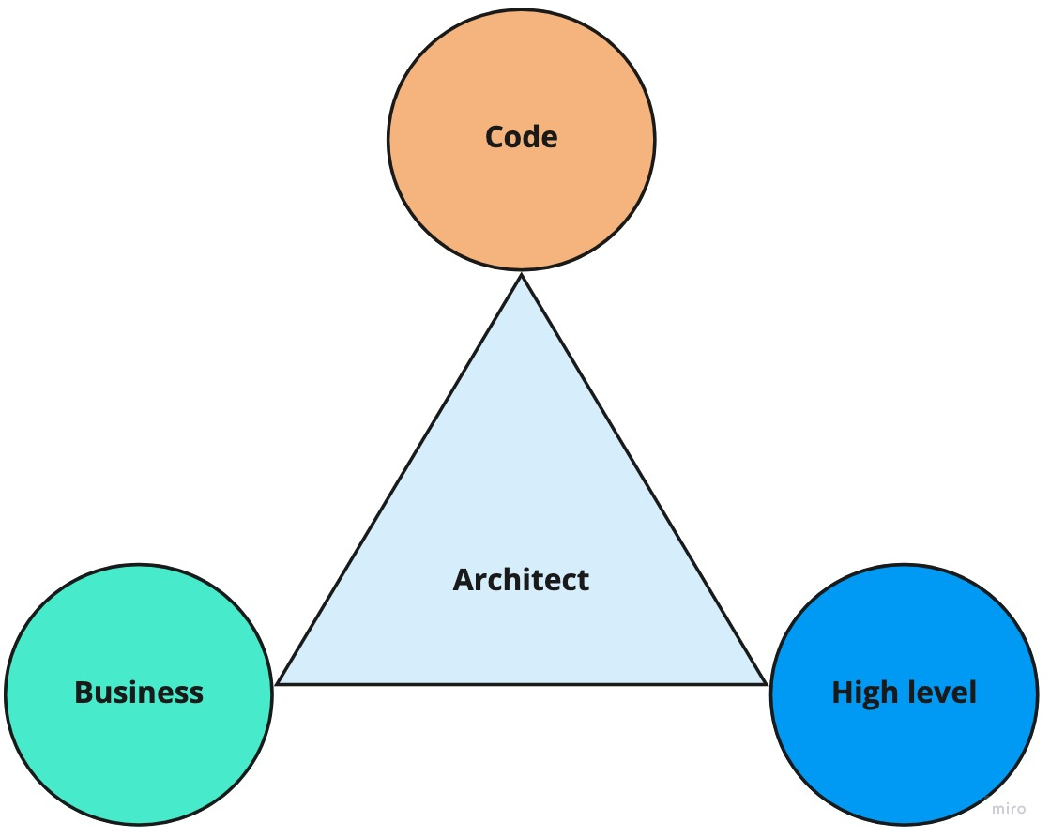
Role Of The Architect Refactoring

Slide 82

Who Should Become An Architect?
?

Slide 83
Who Should Become An Architect?
A corollary to the role of the architect refactoring
Excellent engineers?
Most experienced ones?
Problem solvers?
Great communicators?

Slide 84
Architect’s Role
Qualities
Can teach with empathy
Wide variety of development experience
Good communications skills
Not shying away from getting hands dirty from talking to business or code
Ability to handle uncertainty
Pragmatic

Slide 85

PARTING THOUGHTS

Slide 86
Architecture
Microservices
Autonomy
“With great power (of Autonomy) comes great responsibility”
They can bring in a lot of churn in the org

Slide 87
Takeaways Architecture
The Why - Intentional direction
The What - Decisions
The How - Pictures, Code, Mentoring
The When - Asynchronously, when the Important decisions are made
For Who - People

Slide 88
Takeaways Architect
The who
Mentors
Regularly codes
Becomes the change (Do as I do)
Results oriented
Has strong opinions but weakly holds them

Slide 89
Architect

Slide 90
Questions

Slide 91
Thank you & Contact Me
 | aradhye.com
 | yaradhye
 | yogiaradhye
 | YogirajA

